Slide 1
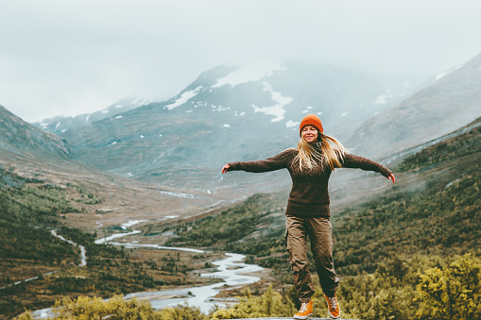
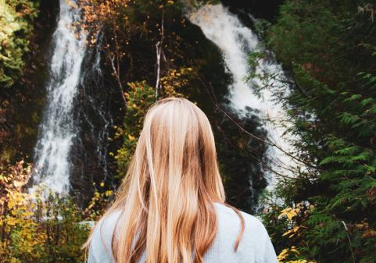
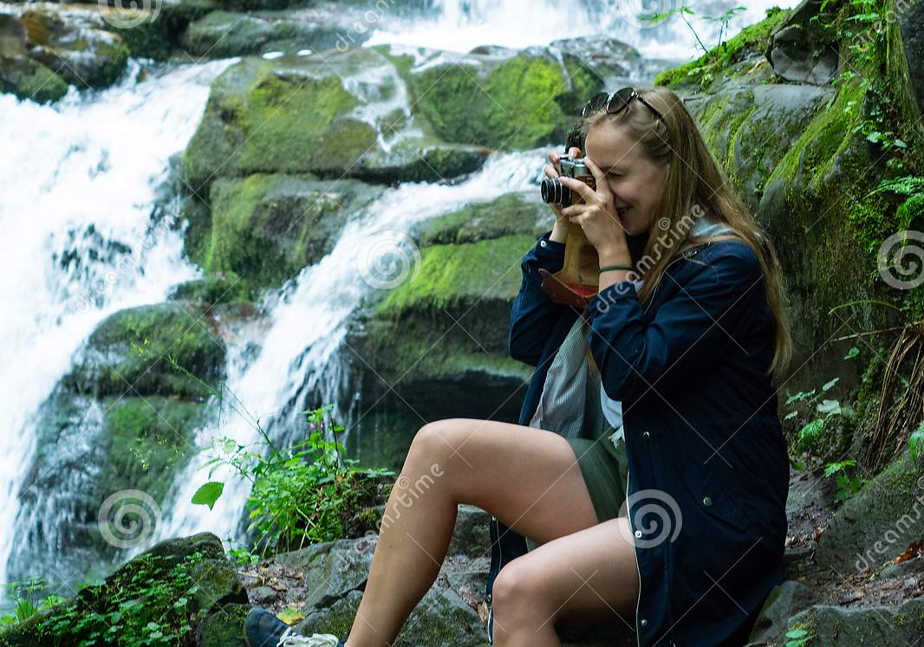
Jane Learns Photography
1
1
Introducing Jane: a girl on a
hike with her camera
Jane waves & holds up her camera
Narrator
Facing Jane
2
Jane finds a waterfall on trail
Jane gasps and smiles
*gasp*, *waterfall*
Behind jane, at waterfall
3
Jane grabs her camera
and snaps a picture on Auto mode
Jane takes a picture
*click*
Sideview: Jane taking picture

Slide 2
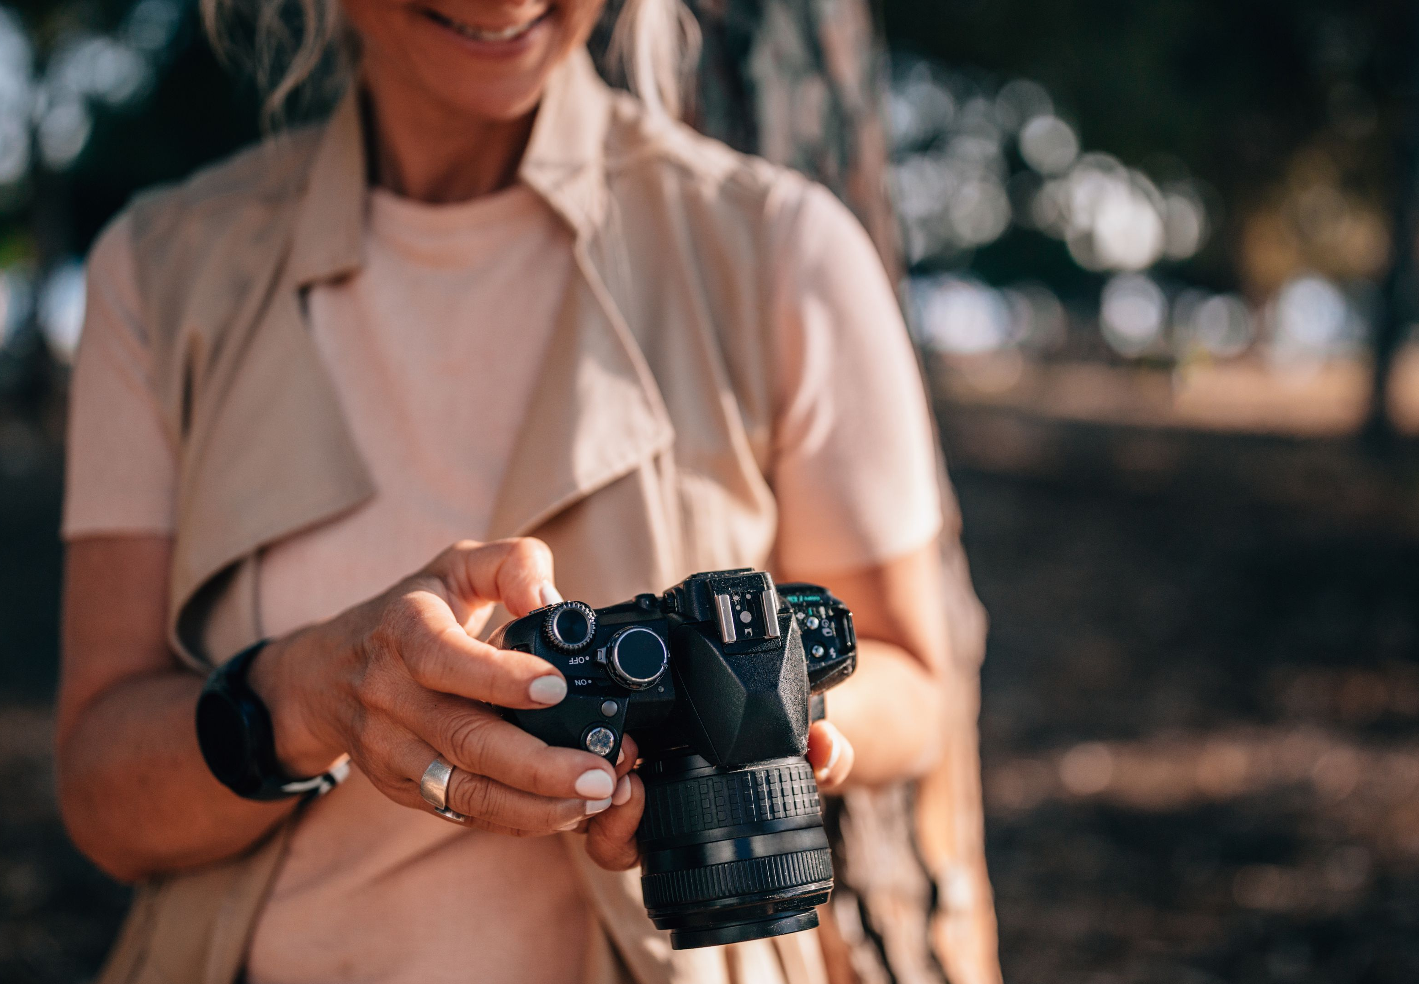
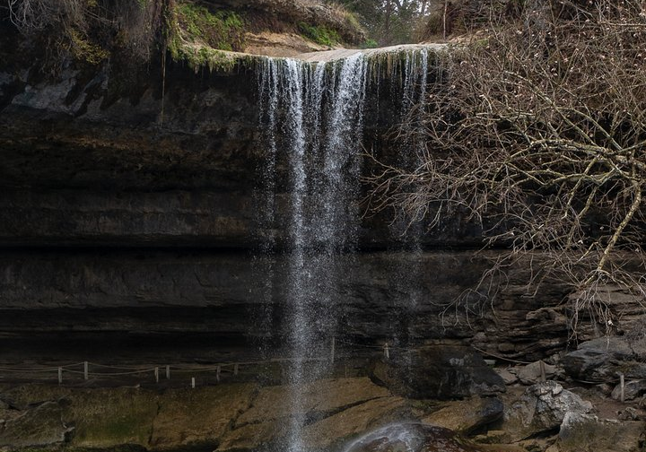
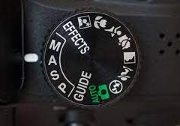
Jane Learns Photography
2
1
Jane’s picture is static
and does not capture the picture well
Jane looking at picture, sad
“oh..” Narrator
Jane looking at her camera
2
Jane shows original photo
Jane shows her picture to film crew
“it’s not as good as I hoped”
Looking at Jane’s camera screen
3
Jane changes mode to M
Jane shifts camera modes
“hmm.” Narrator
Looking at mode wheel

Slide 3
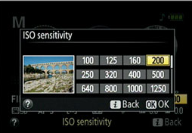
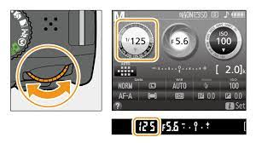
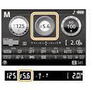
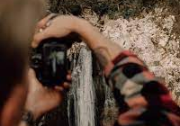
Movie Title
3
1
3
Jane adjusts ISO
Jane adjusts shutter speed
narrator
narrator
Shows camera screen
Shows camera screen
2
4
Jane adjusts aperture
Jane tries another picture
narrator
*click* Narrator
Shows camera screen
Behind Jane towards water

Slide 4
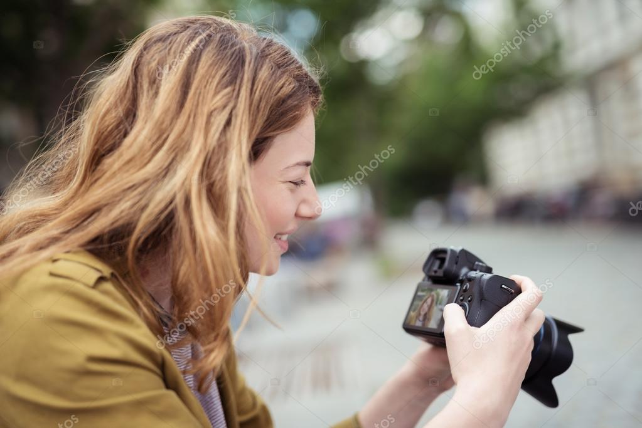
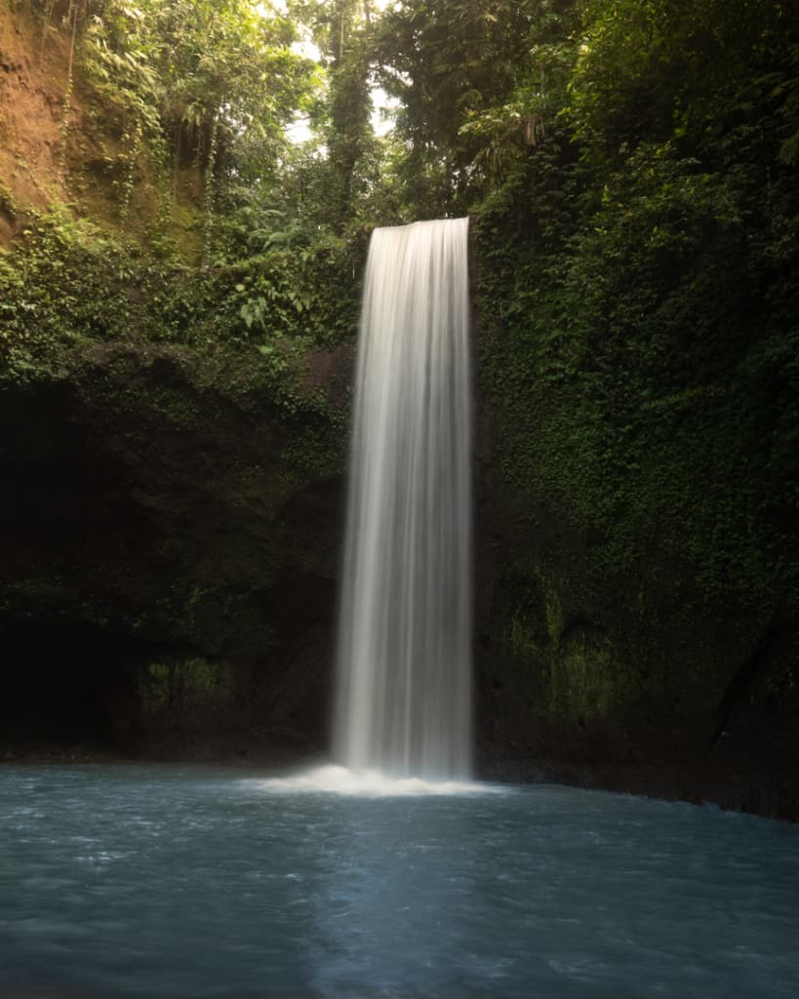
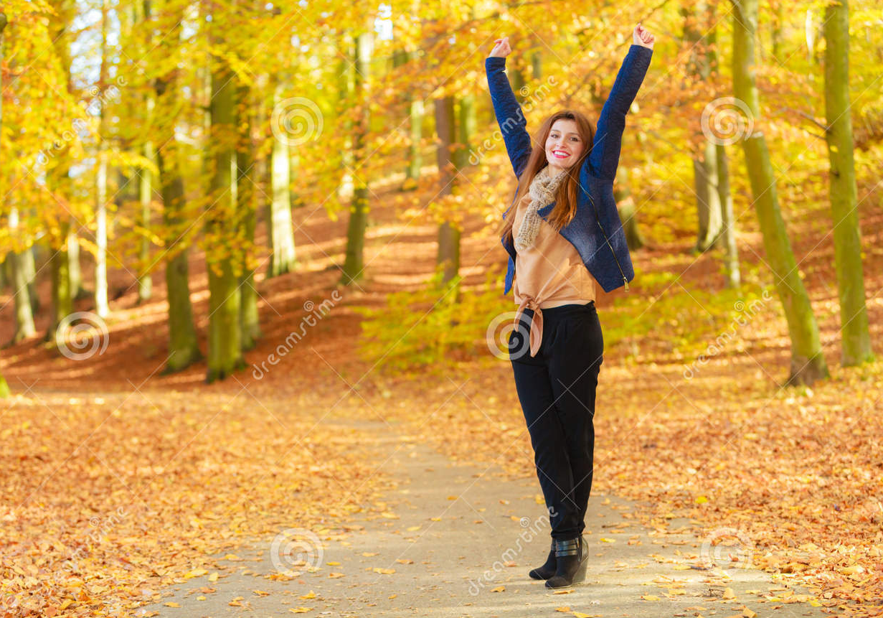
Jane Learns Photography
3
1
Jane looks at recent photo
Jane smiles at her camera
“cool” Narrator
Jane looking at her camera
2
Jane shows picture to
audience
Jane turns camera to film team
“look at this!” Narrator
Looking at Jane’s picture
3
Jane thanks me
Jane waves at camera
“thank you!” Narrator
Facing Jane who is waving

